Slide 1






GIT AND GITHUB

Slide 2
TABLE OF CONTENTS
What is Git? Github and Gitbash
Installation & Setup
Git config, lifecycle & Creating our first repository
Operating Github through Gitbash
Github – Collaborators, branching, merging, merge conflicts and pull requests (with fork).
Our project
01
03
06
04
05
06
07

Slide 3

INTRODUCTION
Harkamal Bains | 2310991838
Harmanjot Singh | 2310991839
Jagjot Singh | 2310991852
Khushi Chauhan | 2310991872
Krish Aggarwal | 2310991876

Slide 4


What is Git?
Git is a popular version control system used by developers to track changes in code over time. It's like a time machine for our code, allowing us to revert to previous versions if necessary and develop on codes collaboratively.

Slide 5


Github and Gitbash
GitHub is a web-based platform and hosting service for software development projects that use the Git version control system. It offers a wide range of features and tools to facilitate collaboration, code sharing, and project management. Github can be operated by Gitbash.
Git Bash is a command line interface (CLI) tool that provides a Unix-like shell environment on Windows systems. It allows users to interact with Git, a popular version control system, and execute Unix-like commands.

Slide 6
INSTALLATION AND SETUP

Slide 7







STEP 01
STEP 02
STEP 03
One can download Gitbash by going on this link and following steps given there:
https://git-scm.com/download
. After downloading, Gitbash can be installed easily.
.To check the version installed, after launching gitbash, one can type the command: ‘git –version’ in the terminal.

Slide 8

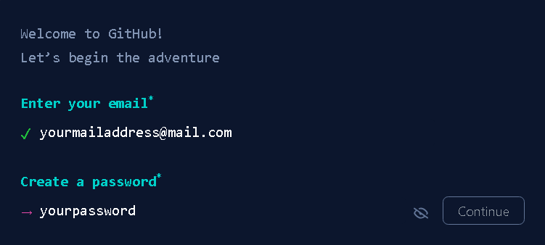
Setting up our Github account
To create a Github account, we can type ‘www.github.com’ and go to the official website, enter your credentials there and click on sign up.

Slide 9
Git config, lifecyle and creating our first repository

Slide 10
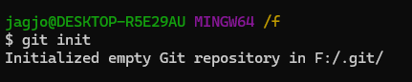
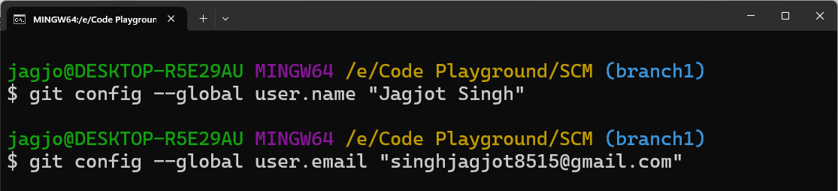
Git Configuration
Git initialization – we can initialize a git folder in our desired folder to enable the git functionalities.
Git configuration

Slide 11
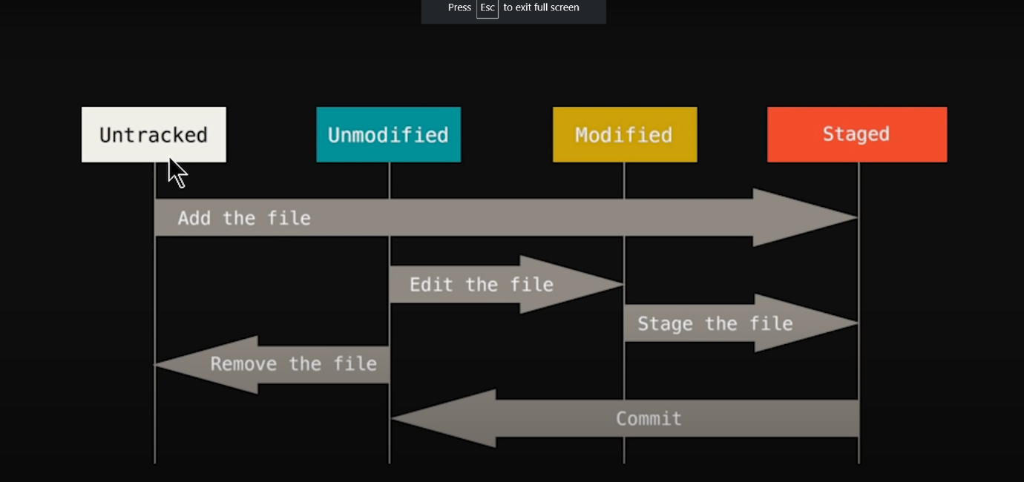

GIT LIFECYCLE
Untracked – The files which are not being tracked by git such as .gitignore, log files or binary files.
Staged – Only the files which are to be committed are added to the staging area using the ‘git add’ command.
Unmodified – This is the indicator that our files have been committed or, git has taken a snapshot of these files and are now unmodified.
Modified – If we make any changes in the committed files, they will be indicated as ‘modified’ and again these will have to be added to the staging area to be committed.

Slide 12
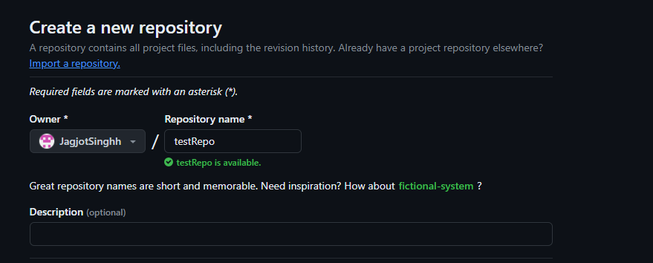
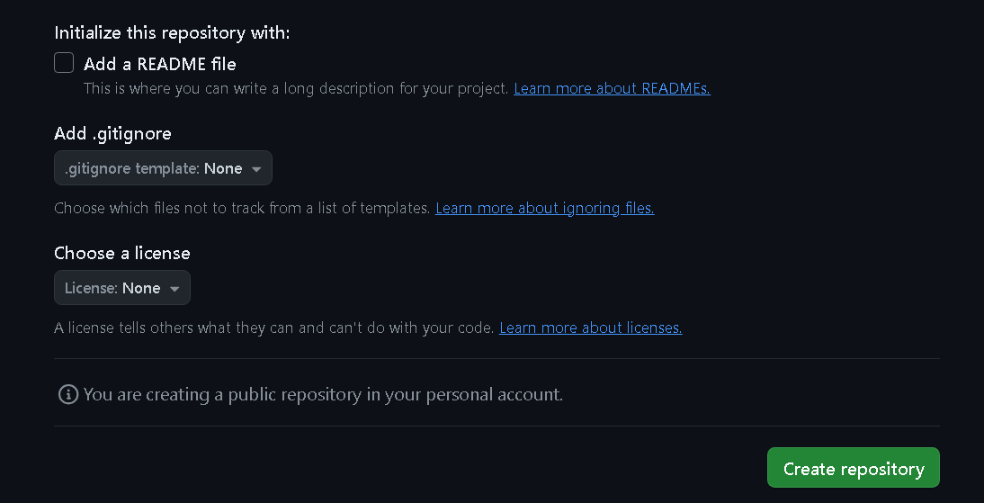

Creating our first Github Repository.
To create your first repository, we first need to log in to our Github account or make one if not signed up already. Then got to the link: https://github.com/new and enter the required details about the repo.

Slide 13



Operating Github through Gitbash

Slide 14
Some commonly used Git commands
Commands | Description
ls | Gives a list of the files and folders in the current working directory.
mkdir | Creates a directory/folder with the given name.
touch “filename.ext” | Creates a file with the given extension in the current working directory.
git add [file(s)] | Adds file(s) to the staging area, preparing them to be committed.
git commit -m "commit message" | Commits staged changes to the repository with a descriptive message.
git status | Shows the current status of the repository (modified, tracked, untracked files).
git config --global user.name “uname” | Sets the user name at the global level to be shown in all further commits .
git config --global user.email “xyz@12.com” | Sets the user email at the global level to be shown in all further commits .
git remote add origin “URL” | Links the local machine to the remote repository through git for a new repo.
git remote set-url origin “URL” | Changes the already existing repository through git.

Slide 15
Some commonly used Git commands
Commands | Description
git remote -v | Lists all remote repositories associated with the local repository.
git clone “URL” | Clones a repository from a remote server to your local machine.
git pull | Fetches changes from a remote repository and merges them into the local branch.
git push | Pushes committed changes from the local repository to a remote repository.
git branch | Lists all branches in the repository.
git checkout “branchname” | To switch to a different branch.
git branch –d “branchname” | To delete a branch.
git merge “branchname” | Merges the specifed branch with the current branch.
git log/ git log --oneline | Displays a history of commits in the repository.
Some other commands include: git init, rm, mv, clear, history etc.

Slide 16

Github – Collaborators, branching, merging branches, merge conflicts and pull requests.

Slide 17
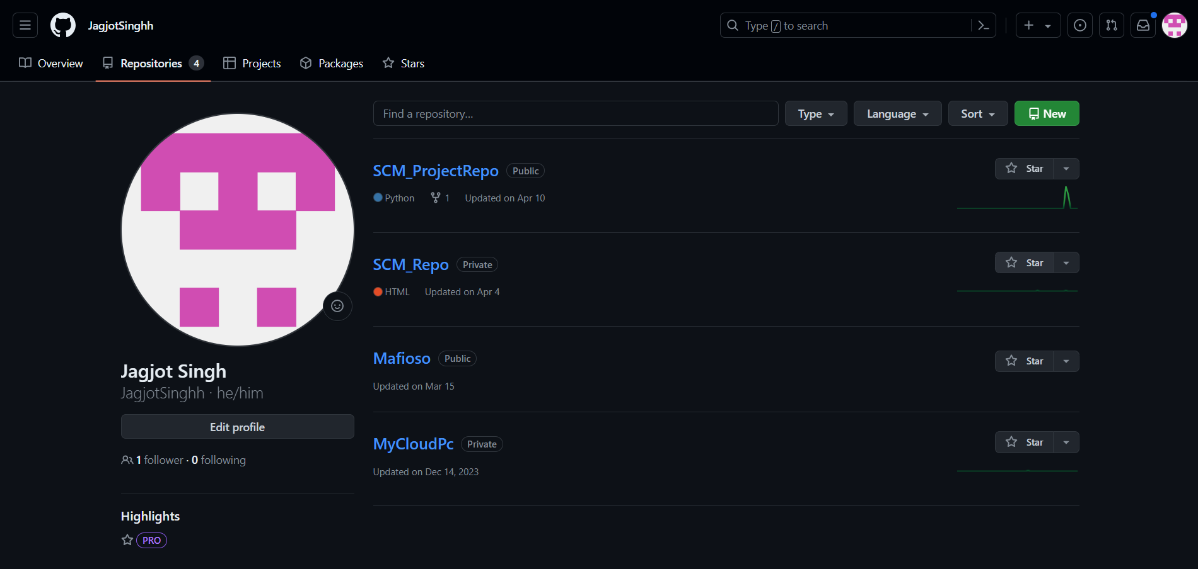
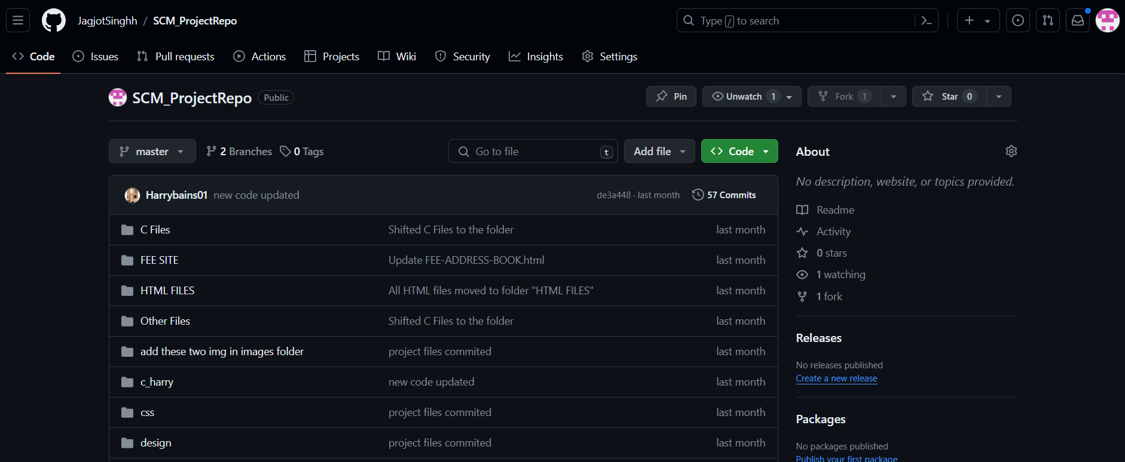
Adding collaborators to our GitHub repository
After logging in to our Github account, click on the repository to which we want to add collaborators

Slide 18
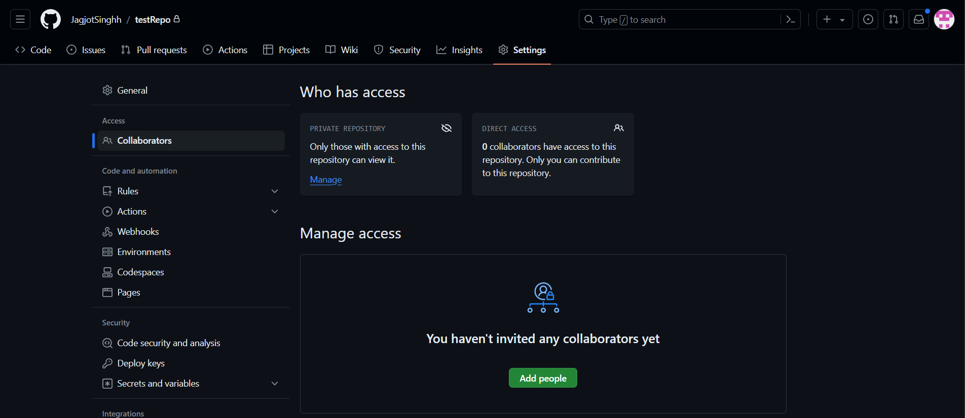
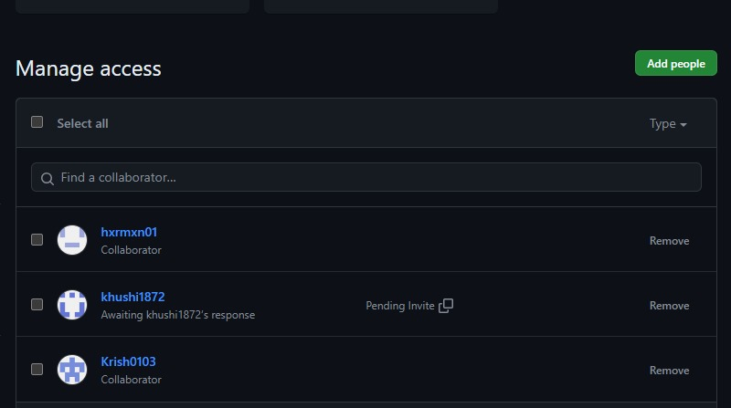
After entering the password or the 2FA code the collaborators page will open, then click on Add people.
Finally, we will have the desired people added as collaborators to our repository

Slide 19
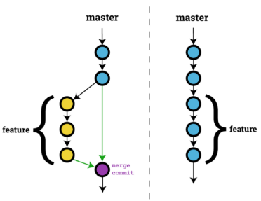
Branching in Git
Branching in git is a core part of development of almost every project. It allows the developers to:
Isolate changes: Create a branch to isolate your changes from the main codebase. This prevents accidental breaks in the main project,
Parallel Development: Multiple developers can work on different features simultaneously using separate branches. This improves development speed and efficiency and
Trying Out Ideas: Use branches to experiment with risky changes or test out new ideas. If something goes wrong, we can easily discard the branch without affecting the main project.
Branches in Gitbash can be:
. made using the “git branch ‘branchname’ ” command,
. merged using the “git merge ‘branchname’ “ command or
. deleted using the “git branch –d ‘branchname’ “ command as
mentioned in the section 04.

Slide 20
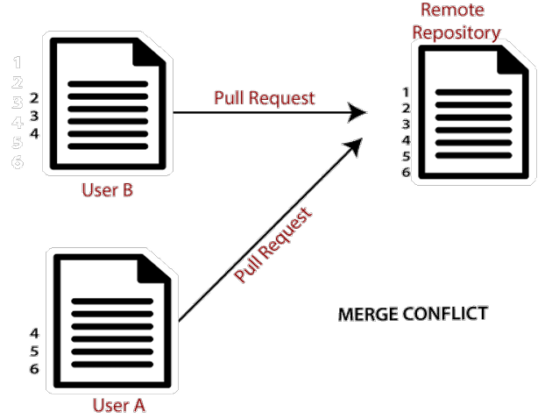
Merge conflicts in branches
Imagine you and a teammate are working on separate branches of the same project. You both modify the same line of code in a file. When you try to merge your branch with the main branch, Git encounters these conflicting changes and cannot automatically determine which version to keep and displays a ‘merge conflict error’. This is a merge conflict.
To resolve, both of you will have to decide which change to keep and which to discard. After deciding, the files has to be added, committed then pushed to the repo.

Slide 21
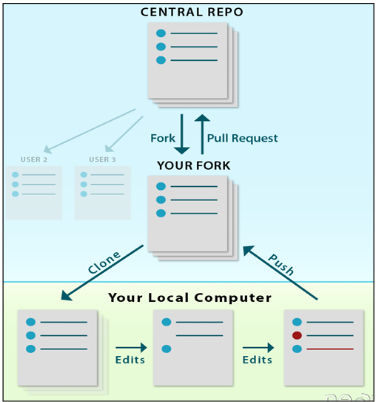
Pull requests and Fork
Pull requests and forks work hand in hand.
A pull request is a formal way to propose merging changes from one branch (usually your feature branch) into another branch (often the main branch). It acts as a notification and communication channel for code review and discussion before integrating your changes.

Slide 22
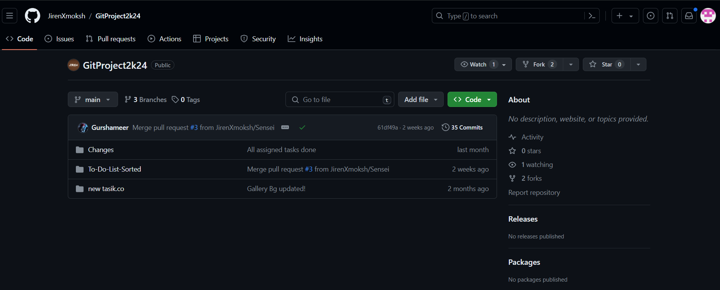
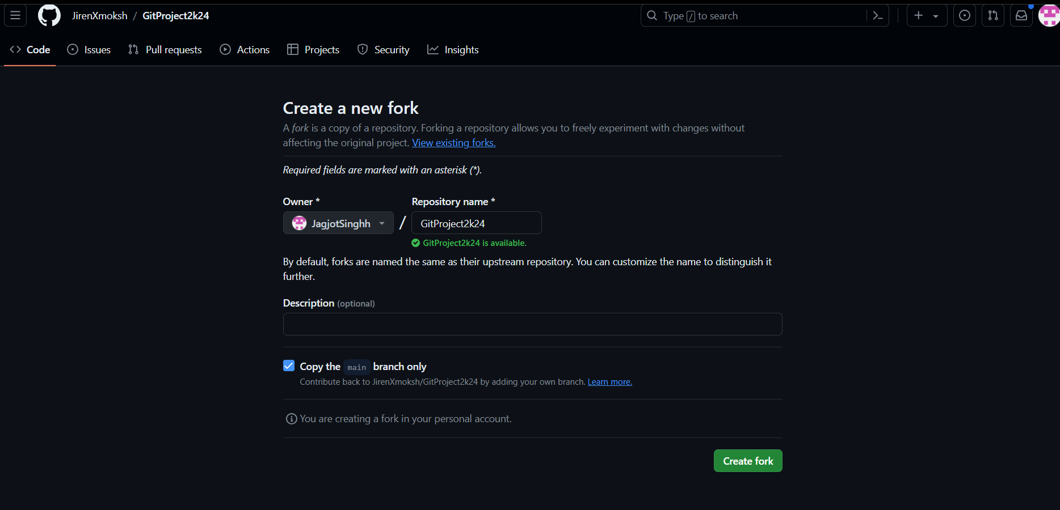
Forking: Search for the repository you want to fork.
On the top right corner, click on ‘Fork’ then enter the required details then click on ‘create fork’.
You will now have an exact copy of the repository in your Github account. To use it (through Gitbash), we have to copy the HTTPS URL of the repository and paste it in the bash terminal using the “git clone ‘URL’ “. You will now have the files in your local machine.

Slide 23
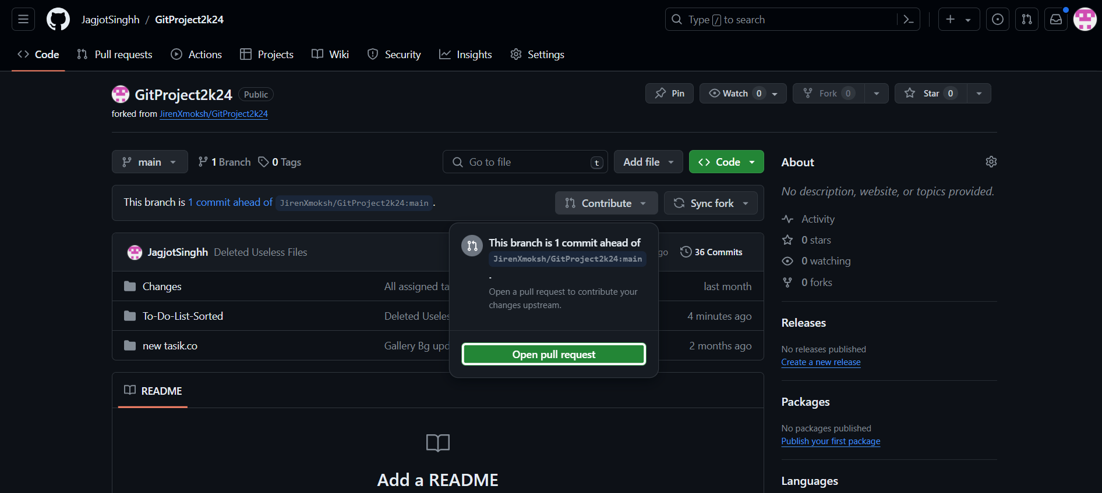
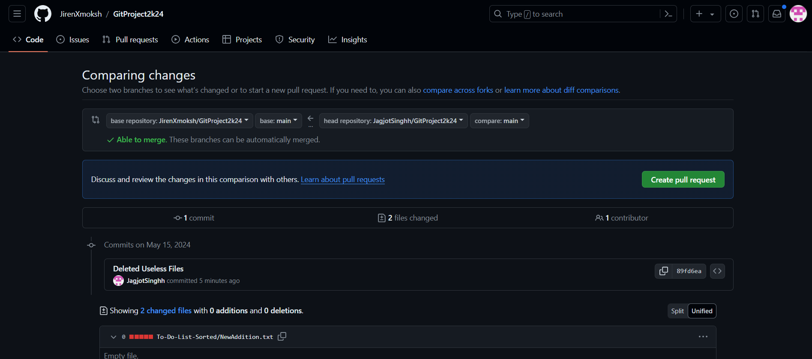
Creating a pull request: Finally after making the required changes, we can add, commit and push them to the forked repository (which exists in our account). Now for ‘your’ changes to be seen in the parent repository, you will have to create a pull request to the owner of the repository. For that, go to Github and refresh, you will be able to see the changes made by you in the repository in ‘your account’. Click on ‘contribute’ then click on ‘Create pull request’ to send a pull request to the host of the repository so that changes proposed by you are accepted and merged into the main repository.

Slide 24

Our
Project

Slide 25

THANK YOU!

